Slide 1
Data acquisition and linkage
+ adaptation of shape and data format

Slide 2
Agenda
Feedback from previous week
Quick recapitulation + Example of questions on topics from previous week
Where and how to get data
How to transform them to the form we need
Linkage of various sources of data

Slide 3
Feedback from previous week
During labs held before the lecture, we waste a lot of time searching for things explained in the lecture and subsequently, we can’t finish a lot of exercises on time.

Slide 4
Recapitulation – Explorative analysis
Get to know your data!
Make sure what is the question you are trying to answer
Use suitable metrics and visualizations
Different types of methods for different types of data
Single attribute analysis
Pair analysis
Numerical – Numerical
Numerical – Categorical
Categorical – Categorical

Slide 5
An example of questions on topics from previous week
Which of these methods is possible to use for pair analysis of two continuous attributes?
Histogram
Bar chart
Boxplot
Scatterplot
Frequency (contingency) table
Pearson correlation coefficient

Slide 6
An example of a question, that is too deceitful to use it in exam, but that is too funny to miss an opportunity to use somewhere. Yes, I think it is funny because I created it ☺
Pearson correlation of person’s age and health in our dataset is -1,09. What can we tell based on this statement?
Age is good predictor of health
Age is bad predictor of health
Possibility 1 and 2 are correct
Learning by game (lat. Homo Ludens) is an effective method of teaching
Lecturers are trolls
All possible answers

Slide 7
Data acquisition and linkage

Slide 8
ETL (Extract, Transform, Load)
The term is most often used in connection with Data Warehousing
Analyzed in detail in Advanced database systems course
We are going to talk about basic concepts and few techniques we will find useful
Extract – extract data from source systems
Transform – Link, correct / clean, consolidate data to a homogeneous form
Load – save data in a form most suitable for processing

Slide 9
Typically very complicated systems linking many diverse sources
SQL procedures, transformations using scripts, Message Queue (Kafka), Spark
Results are tables in some distributed file system. Ideally in the form of Star-schema
Querying typically using SQL or MapReduce tasks (or language translated into MR tasks)

Slide 10
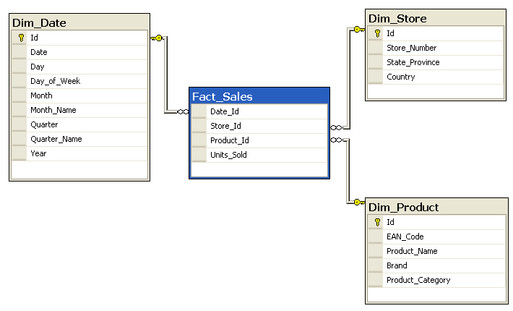
Star-schema
Tables of facts and dimensions
Queries have common form (select + inner join + where + group by + agg)
Saves storage and is reasonably quick in execution
=> Snowflake schema
Image source.: https://en.wikipedia.org/wiki/Star_schema

Slide 11
We will stay at the level of only several tables

Slide 12
Data sources

Slide 13
Well prepared datasets ready to work
UCI - http://archive.ics.uci.edu/ml/index.php
Kaggle Datasets - https://www.kaggle.com/datasets
Metasearch engines (unfortunately some are payed)
Google Dataset Search - https://toolbox.google.com/datasetsearch
Quandl - https://www.quandl.com/

Slide 14
Open data
http://opendata.sk
https://data.gov.sk/
https://ekosystem.slovensko.digital/
https://slovak.statistics.sk
https://ec.europa.eu/eurostat
http://databank.worldbank.org/data/home.aspx

Slide 15
Many research institutions make their data public
CERN - http://opendata.cern.ch/
NASA - https://data.nasa.gov/

Slide 16
API
Application developers want to make data access easy or they want people to build applications on top of theirs.
Typically many restrictions when working with personal data.
Open (restrictions) and played as well.
Facebook
Twitter
Google
...
ProgrammableWeb - https://www.programmableweb.com/apis/directory

Slide 17
Logs / measurements (sensors)
Weblogs of user activity ( we had many such projects at the faculty)
Eyetracking, EEG, temperature, humidity, acceleration, ...

Slide 18
Various formats
Various forms
Various quality

Slide 19
Data transformation

Slide 20
Not going to talk about transformation between various data formats (XML, CSV, JSON, BIN ...)
Not going to talk about extraction of features from data (images / sound / text ...)
We will get to this partially in later presentations
We will focus on tabular data and manipulation with them

Slide 21

goto Jupyter

Slide 22
Data linkage
When JOIN in relational database is not enough

Slide 23
Entity Resolution
Entity Resolution refers to techniques that identify, group, and link digital mentions or manifestations of some object in the real world.
Common name for:
Deduplication
Reference matching
Record linkage

Slide 24
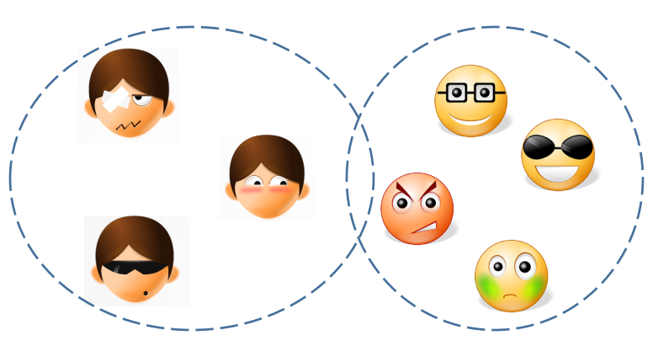
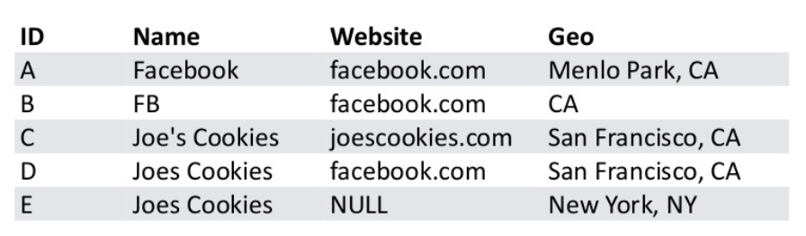
Deduplication
The process of clustering and linking of entries representing the same entity.
Exact match
Exact match on key attributes
Rules
Similarities
Works with a single database at the same time
Key task – find /create cluster representative
Often the most complete record
Complete missing values
Project

Slide 25
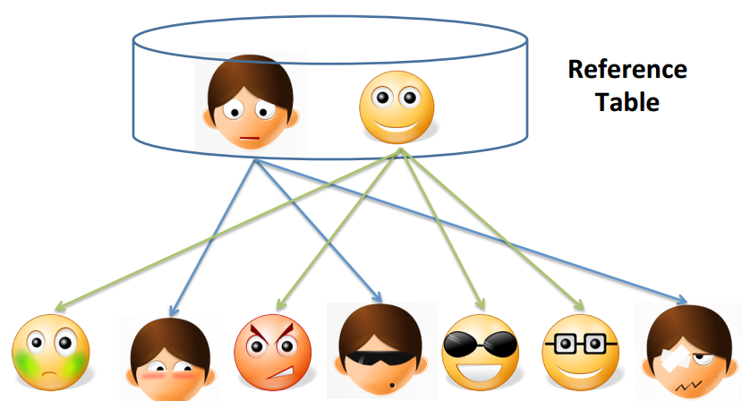
Reference matching
Link noisy data with records in a reference table.
Similar approaches as deduplication but computationally more demanding – we work with multiple tables / databases

Slide 26
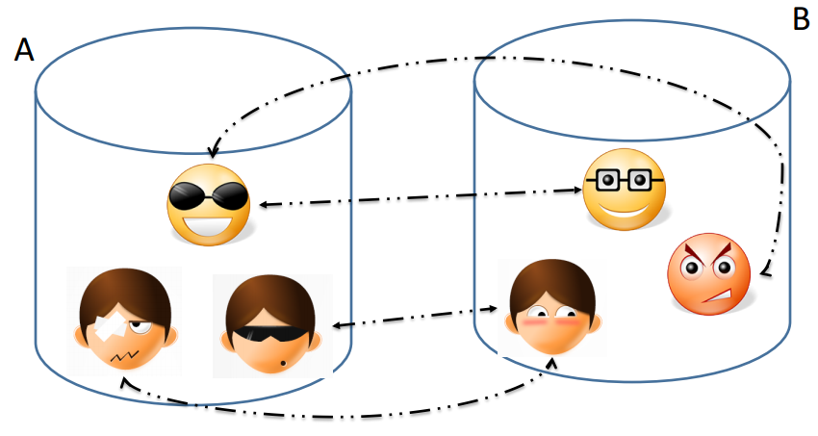
Record linkage
Search for equivalent records between various databases.
Computationally very demanding
For d databases with n records requires O(n^{d}) comparisons
Many approaches (in decreasing order of reliability)
Exact match
Similar to SQL join on multi index
Learned rule match
Distance match
Atribute weighting, necessary conditionsClustering, Feature extraction
Project

Slide 27
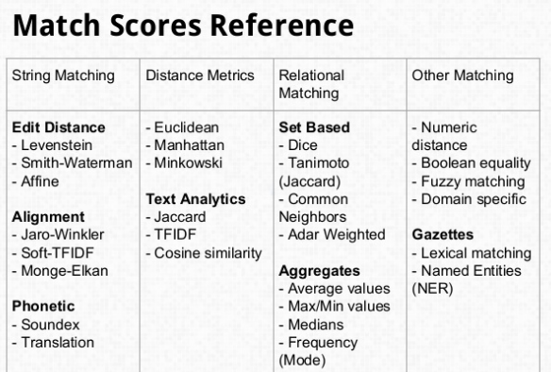
Similarities
A base for most techniques is som similarity measure
Image source: https://www.slideshare.net/BenjaminBengfort/a-primer-on-entity-resolution

Slide 28
Scalability on BigData With the difficulty of matching every possible pair of records doesn’t even have to be so big to be very hard to process
Many unnecessary comparisons. Heuristics to reduce that number.
Blocking – division of the search space using values of selected attribute. Comparison only among records with the same value of the attribute.
Eg. comparing only records from the same city
Could use hierarchy of block for example for dates and places
Locally sensitive hashing – fast exact or approximate search and comparison only with small neighborhood of the record
On hashed representation of the record we can perform fast similarity search and we can use various optimizations.
Canopy clustering – greedy creation of big umber of clusters and comparison only within a single cluster

Slide 29
Project

Slide 30
Datasets
There is 100 datasets. Sign in pairs to one of these datasets in this document
https://tinyurl.com/iau-vyber-datasetov
Download the dataset with selected number from here
https://tinyurl.com/iau-data
Every dataset is composed from 4 files. 2 for training and 2 for validation. They have the same structure, only records are different. Predicted value is in the column class.
https://github.com/sevo/IAU-2018-2019/blob/master/podmienky_absolvovania_a_projekt.pdf

Slide 31
Feedback: tinyurl.com/iau2018-19

